Slide 1
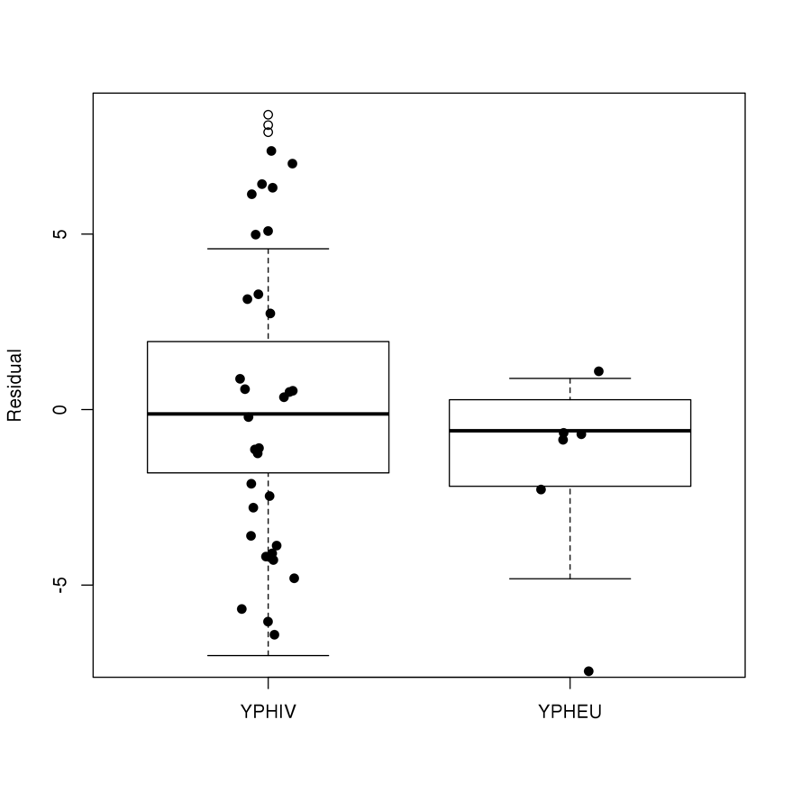
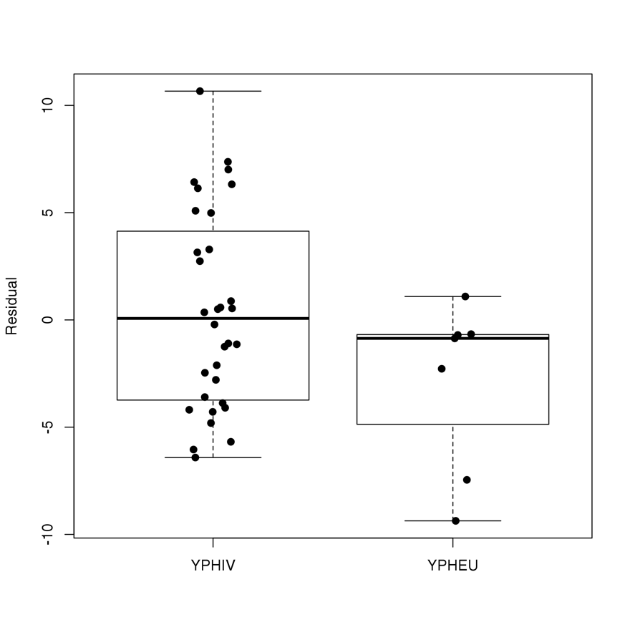
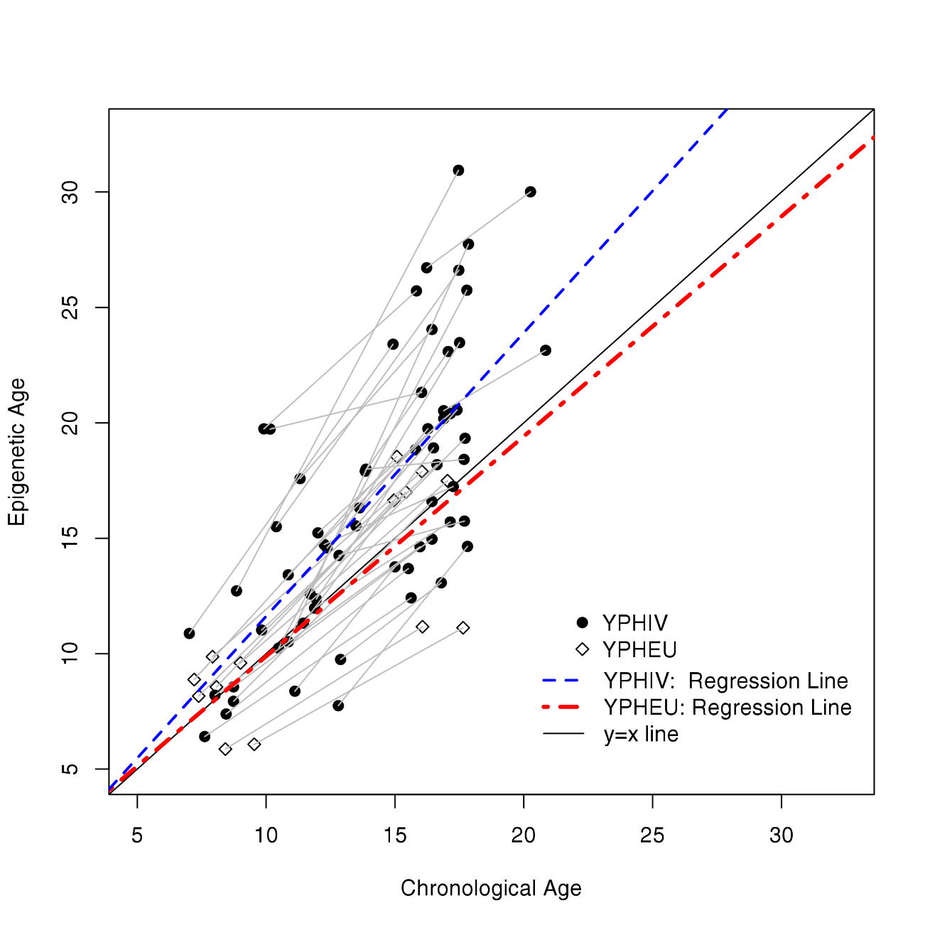
Longitudinal changes in epigenetic age in youth with perinatally-acquired HIV (YPHIV) and youth who are perinatally HIV-exposed uninfected (YPHEU)
PEB0312
Authors: Stephanie Shiau¹, Sean S. Brummel², Elizabeth M. Kennedy³, Karen Hermetz³, Rohan Hazra⁴, Stephen A. Spector⁵, Paige L. Williams^{2,6}, Deborah Kacanek^{2,6},
Renee Smith⁷, Stacy Drury⁸, Allison Agwu⁹, Angela Ellis¹⁰, Kunjal Patel^{2,6}, George R. Seage III⁶, Russell Van Dyke¹¹, Carmen J. Marsit³, for the Pediatric HIV/AIDS Cohort Study (PHACS)
Affiliations: ¹Department of Biostatistics and Epidemiology, Rutgers School of Public Health, Piscataway, NJ, USA; ²Center for Biostatistics in AIDS Research, Harvard T.H. Chan School of Public Health, Boston, MA, USA;
³Department of Environmental Health, Emory University Rollins School of Public Health, Atlanta, GA, USA; ⁴Maternal and Pediatric Infectious Disease Branch, Eunice Kennedy Shriver National Institute of Child Health and Human Development,
National Institutes of Health, Bethesda, MD, USA;⁵Department of Pediatrics, University of California, San Diego, La Jolla, CA, USA;⁶Department of Epidemiology, Harvard T. H. Chan School of Public Health, Boston, MA, USA;
⁷Department of Pediatrics, University of Illinois at Chicago, Chicago, IL, USA;⁸Department of Child and Adolescent Psychiatry, Tulane University School of Medicine, New Orleans, LA, USA;
⁹Departments of Pediatric and Adult Infectious Diseases, Johns Hopkins University School of Medicine, Baltimore, MD, USA;¹⁰Frontier Science & Technology, Amherst, NY, USA;¹¹Department of Pediatrics, Tulane School of Medicine, New Orleans, LA, USA
Contact:
Stephanie Shiau, PhD, MPH
Instructor of Epidemiology
Rutgers School of Public Health
Department of Biostatistics and Epidemiology
stephanie.shiau@rutgers.edu
BACKGROUND
METHODS
RESULTS
SUMMARY
The onset of age-related conditions (e.g. osteoporosis, dementia) often occurs earlier in life among those living with HIV than those without HIV, suggesting accelerated aging is occurring in people with HIV.
Recently, research has begun to characterize molecular profiles, such as patterns of DNA methylation, that reflect this accelerated aging, which can be inferred when the estimated biological age exceeds chronological age.¹
Accelerated epigenetic age (i.e. patterns of DNA methylation that correspond to an estimated biological age that exceeds chronological age) has been linked to aging-related outcomes, including all-cause mortality, frailty, and cognitive decline in the elderly.
Cross-sectional studies have reported epigenetic age acceleration in adults living with HIV on ART,²⁻⁴ but few studies have examined this question amongst youth with perinatally-acquired HIV (YPHIV), and findings have not been consistent.^{5,6}
Statistical Analysis
Table 1: Characteristics of 32 YPHIV and 7 YPHEU by group
Table 2: HIV-Related Characteristics at Two Timepoints for YPHIV
To our knowledge, this is the first study to examine longitudinal changes in epigenetic age compared to chronological age over time in YPHIV, making use of repeated samples over time.
We observed accelerated epigenetic aging over time in YPHIV, but not in YPHEU.
This longitudinal observation is consistent with findings from cross-sectional studies of individuals with HIV, which have reported a higher increase in the gap between epigenetic age and chronological age among ART-treated individuals with HIV and HIV-uninfected controls.²⁻⁵
We found that a lower cumulative CD4 T-cell count and a higher cumulative HIV RNA VL were associated with accelerated epigenetic aging. We also observed that those not on ART had a higher epigenetic age compared to those on ART and those with a higher percentage of time not on ART tended to have higher epigenetic ages.
Our small sample size limited our ability to explore whether epigenetic age acceleration in YPHIV may be associated with early markers of other age-related comorbidities, such as dyslipidemia, impaired renal function, or low bone mineral density, but future larger longitudinal studies to explore these associations, including studies utilizing banked specimens from the PHACS, are warranted.
Descriptive statistics were used to summarize demographic and clinical characteristics of the subset of YPHIV and YPHEU selected for this analysis at the two time points. Given the modest sample size with repeated measures, we evaluated the 32 YPHIV and 7 YPHEU separately, rather than attempting to statistically compare these two groups.
At each of the two timepoints, an epigenetic age acceleration residual was calculated as the difference between epigenetic age and chronological age.
Box and whisker plots were used to graphically depict the epigenetic age acceleration residual at timepoint 1 and timepoint 2 separately for YPHIV and YPHEU.
Scatter plots were used to graphically depict epigenetic age by chronological age for YPHIV and YPHEU.
To examine longitudinal changes in epigenetic age compared to chronological age, linear mixed effects models were fit to estimate the average change in epigenetic age for a one year change in chronological age separately for YPHIV and YPHEU.
Given the small sample size, a limited number of additional covariates (HIV status, sex, geographic region, race, and cell type proportions) were investigated as additional predictors of epigenetic age in separate linear mixed effects models including chronological age.
Among YPHIV only, ART regimen, time-averaged AUC CD4 T-cell count and HIV RNA VL were evaluated as additional predictors of epigenetic age in separate linear mixed effects models and together in a single model including chronological age.
Statistical analyses were all performed using R statistical software, version 3.4.4 (Vienna, Austria) and SAS, version 9.4 (Cary, North Carolina, USA). Statistical significance was defined using two-sided P-value less than 0.05.
Characteristic | YPHIV (N=32) | YPHEU (N=7) | Total (N=39)
Chronological age at Timepoint 1 (years), Median (Q1, Q3) | 11.4 (9.9, 12.8) | 8.1 (7.4, 9.0) | 10.9 (8.7, 12.4)
Chronological age at Timepoint 2 (years), Median (Q1, Q3) | 17.0 (16.2, 17.6) | 16.0 (15.1, 17.0) | 16.8 (16.0, 17.5)
Time between Timepoint 1 and 2 (years), Median (Q1, Q3) | 5.2 (3.9, 7.1) | 8.0 (7.6, 8.1) | 6.0 (4.0, 7.7)
Sex, N (%)
Male | 16 (50.0%) | 4 (57.1%) | 20 (51.3%)
Female | 16 (50.0%) | 3 (42.9%) | 19 (48.7%)
Race, N (%)
White | 10 (31.3%) | 2 (28.6%) | 12 (30.8%)
Black | 21 (65.6%) | 5 (71.4%) | 26 (66.7%)
Other | 1 (3.1%) | 0 (0.0%) | 1 (2.6%)
Site Region, N (%)
Northeast | 9 (28.1%) | 0 (0.0%) | 9 (23.1%)
South | 3 (9.4%) | 0 (0.0%) | 3 (7.7%)
West | 6 (18.8%) | 3 (42.9%) | 9 (23.1%)
Midwest | 14 (43.8%) | 4 (57.1%) | 18 (46.2%)
Age at First ARV (years), Median (Q1, Q3) | 0.2 (0.2, 0.5)
Age at First HAART (years), Median (Q1, Q3) | 0.3 (0.2, 1.2)
Characteristic | Timepoint 1 | Timepoint 2
Time-averaged AUC CD4 T-cell count (cells/mm³), Median (Q1, Q3) | 1,228 (1,000, 1,530) | 1,140 (879, 1,359)
Time-averaged AUC HIV RNA viral load (log10 copies/ml), Median (Q1, Q3) | 2.5 (2.1, 3.2) | 2.3 (2.0, 2.9)
ART Regimen, N (%)
INSTI-based ART | 1 (3.1%) | 8 (25.0%)
PI-based ART | 25 (78.1%) | 7 (21.9%)
NNRTI-based ART | 3 (9.4%) | 10 (31.3%)
Other ARV | 1 (3.1%) | 3 (9.4%)
No ARV | 2 (6.3%) | 4 (12.5%)
Figure 1: Epigenetic age acceleration residual at timepoint 1 and timepoint 2 by HIV status
(a) HIV status (x-axis) vs. age acceleration residual based on Horvath 2013 (y-axis) at timepoint 1.
(b) HIV status (x-axis) vs. age acceleration residual based on Horvath 2013 (y-axis) at timepoint 2.
OBJECTIVE
We quantified the rate of change in epigenetic age compared to chronological age over time in YPHIV and youth who are perinatally HIV-exposed uninfected (YPHEU), and among YPHIV, examined associations with time-averaged area under the curve (AUC) HIV RNA viral load (VL) and CD4⁺ T-cell count.
Table 3: Predictors of epigenetic age in 32 youth with YPHIV and 7 YPHEU in linear mixed effects models including chronological age
Residual
Residual
METHODS
Model | Covariate | Level | Estimate | (95% CI) | P-value
Model 1 | Chronological age (years) |  | 1.15 | (0.99, 1.31) | 0.067
 | HIV status | YPHIV | 2.47 | (-0.60, 5.55) | 0.11
 |  | YPHEU | Ref.
Model 2 | Chronological age (years) | - | 1.17 | (1.01, 1.33) | 0.038
 | Sex | Female | -1.54 | (-3.92, 0.84) | 0.20
 |  | Male | Ref.
Model 3 | Chronological age (years) | - | 1.15 | (0.99, 1.31) | 0.068
 | Site Region | Midwest | 2.38 | (-0.60, 5.36) | 0.11
 |  | Northeast | 3.76 | (0.32, 7.20) | 0.033
 |  | South | 2.98 | (-1.87, 7.83) | 0.22
 |  | West | Ref.
Model 4 | Chronological age (years) | - | 1.16 | (1.00, 1.32) | 0.051
 | Race/Ethnicity | Black | -0.16 | (-2.82, 2.49) | 0.90
 |  | Other | -3.42 | (-11.35, 4.51) | 0.39
 |  | White | Ref.
Model 5 | Chronological age (years) | - | 0.91 | (0.71, 1.10) | 0.32
 | Percentage of B Cells¹ | - | -0.15 | (-0.32, 0.02) | 0.084
 | Percentage of CD4 T cells¹ | - | -0.13 | (-0.24, -0.03) | 0.014
 | Percentage of CD8 T cells¹ | - | -0.0002 | (-0.0003, -0.00004) | 0.013
 | Percentage of Natural Killer cells¹ | - | -0.09 | (-0.24, 0.06) | 0.23
 | Percentage of Granulocytes¹ | - | -0.005 | (-0.04, 0.03) | 0.76
 | Percentage of Monocytes¹ | - | -0.03 | (-0.17, 0.12) | 0.72
CONCLUSIONS
Study Population
YPHIV
YPHEU
YPHIV
YPHEU
In conclusion, we observed descriptive differences in the rate of epigenetic aging in YPHIV and YPHEU.
Our findings add to the existing research suggesting accelerated biological aging in individuals living with HIV. Older epigenetic aging relative to chronological age has been found to be associated with a wide spectrum of aging outcomes. Our finding of an increased rate of epigenetic age over time in YPHIV provides preliminary evidence of accelerated aging at a young age and may have future consequences.
A major strength of this study was its longitudinal design with repeated measures of epigenetic age. These analyses will directly inform effect sizes and potential confounders to consider in a larger study.
Further, these findings emphasize the importance of early and sustained suppressive treatment for YPHIV, who will age on lifelong ART.
In addition, future work should examine the dynamic nature of epigenetic age, through examinations of differences in viral load over time, or how interventions leading to improved adherence impact epigenetic age.
32 YPHIV and 8 YPHEU with active follow up were selected from the Adolescent Master Protocol (AMP) of the Pediatric HIV/AIDS Cohort Study (PHACS) network, which enrolled YPHIV and YPHEU from March 2007 through November 2009 at clinical sites in the United States and Puerto Rico.
Inclusion criteria included youth with peripheral blood mononuclear cell (PBMC) samples collected at two time points ≥3 years apart, and all YPHIV who had HIV RNA VL measured within 1 year of birth and within 1 year of each of the sample time points.
Participants were selected to have an equal distribution of male and female participants in each group with the largest time difference between the first and last sample.
One YPHEU was excluded from the analyses due to a mislabeling of one of the specimens.
Figure 2: Epigenetic age by chronological age for YPHIV and YPHEU
RESULTS
Epigenetic Age
Table 1: Median age was 10.9 (range 7.0 – 16.9) and 16.8 (range 14.9 – 20.8) years at timepoints 1 and 2, respectively. At timepoint 1, median age was higher in the YPHIV group than the YPHEU group (11.4 vs. 8.1 years). Median duration of time between timepoint 1 and timepoint 2 was 6.0 years (interquartile range [IQR]: 4.0-7.7). Groups were balanced by sex (51% male) and race (67% Black).
Table 2: Median time-averaged AUC CD4 T-cell count was 1,228 and 1,140 cells/mm³ and time-averaged AUC HIV RNA VL was 2.5 and 2.3 log10 copies/ml at timepoints 1 and 2, respectively. At timepoint 1 the majority of YPHIV (78%) were on a protease inhibitor (PI)- containing ART regimen and 2 children (6.3%) were not on ART. At timepoint 2, 12.5% were not on ART.
Figure 1: The median epigenetic age acceleration residual was -0.1 year (IQR: -1.8, 1.9) at timepoint 1 and 0.1 year (IQR: -3.7, 4.1) at timepoint 2 for YPHIV. The median epigenetic age acceleration residual was -0.6 year (IQR: -3.7, 0.7) at timepoint 1 and -0.9 year (IQR: -7.5, -0.7) at timepoint 2 for YPHEU.
Figure 2: Epigenetic age increased for all YPHIV and YPHEU from time point 1 to time point 2.
Table 3 Models 1-4: In linear mixed effects models, epigenetic age increased by 1.22 years (95% confidence interval [CI]: 1.03, 1.42) for YPHIV and 0.95 years (95% CI: 0.74, 1.17) for YPHEU per year increase in chronological age. HIV status, sex, race, and geographic region, were not associated with epigenetic age in separate models including chronological age.
Measurements
Demographic, clinical, and laboratory data were collected through self-report and medical chart abstraction, including information on history of ART, HIV RNA VL, and CD4⁺ T-cell lymphocyte measurements.
Time-averaged area under the curve (AUC) CD4 T-cell count and HIV RNA VL were calculated using the trapezoidal rule from the first VL measurement to each of the sample time points.⁷
DNA was isolated from PBMCs and profiled for genome-wide DNA methylation using the Illumina MethylationEPIC (850K) BeadArray (Illumina Inc., San Diego, CA).
Data were processed via a standardized pipeline implemented by the minfi Bioconductor package using R statistical software, version 3.4.4. We excluded 3070 CpG probes that had poor detection p-values. The final analytic sample included 39 samples and 482,694 probes.
DNA methylation-estimated cell type proportions (B-cells, CD4 T-cells, CD8 T-cells, natural killer cells, granulocytes, monocytes) were calculated using the Houseman method.⁸
Epigenetic age was calculated using the Horvath method (353 CpGs) via the online calculator.¹
Chronological Age
Table 4 Model 6: Among YPHIV, the chronological age-adjusted difference in epigenetic age comparing youth not on ART to those on PI-containing ART was 3.32 years (95% CI: -0.11, 6.75).
Table 4 Models 7: Higher time-averaged AUC HIV-RNA VL was associated with an increase in epigenetic age over time [2.72 years per log10 copies/mL, (95% CI: 1.09, 4.34)]
Table 4 Model 8: Higher time-averaged AUC CD4 T-cell count was associated with a decrease in epigenetic age over time [-0.44 years per 100 cells/mm³, (95% CI: -0.73, -0.14)].
Table 4 Model 9: In a multivariable model, higher AUC HIV-RNA VL was associated with an increase in epigenetic age over time [2.19 years per log10 copies/mL, (95% CI: 0.65, 3.74)], whereas a higher time-averaged AUC CD4 T-cell count was associated with a decrease in epigenetic age over time [-0.34 years per 100 cells/mm³, (95% CI: -0.63, -0.06)] in YPHIV.
REFERENCES
Table 4: Predictors of epigenetic age in 32 youth with perinatally-acquired HIV (YPHIV) in linear mixed effects models including chronological age
Horvath S. DNA methylation age of human tissues and cell types. Genome Biol. 2013;14(10):R115. PMCID: PMC4015143
Gross AM, Jaeger PA, Kreisberg JF, Licon K, Jepsen KL, Khosroheidari M, Morsey BM, Swindells S, Shen H, Ng CT, Flagg K, Chen D, Zhang K, Fox HS, Ideker T. Methylome-wide Analysis of Chronic HIV Infection Reveals Five-Year Increase in Biological Age and Epigenetic Targeting of HLA. Mol Cell. 2016 21;62(2):157–168. PMCID: PMC4995115
Nelson KN, Hui Q, Rimland D, Xu K, Freiberg MS, Justice AC, Marconi VC, Sun YV. Identification of HIV infection-related DNA methylation sites and advanced epigenetic aging in HIV-positive, treatment-naive U.S. veterans. AIDS. 2017 20;31(4):571–575. PMCID: PMC5263111
Horvath S, Levine AJ. HIV-1 Infection Accelerates Age According to the Epigenetic Clock. J Infect Dis. 2015 Nov 15;212(10):1563–1573. PMCID: PMC4621253
Horvath S, Stein D, Phillips N, Heany S, Kobor M, Lin D, Myer L, Zar H, Levine A, Hoare J. Perinatally acquired HIV infection accelerates epigenetic aging in South African adolescents. Aids. 2018 Jul 1;32(11):1465–1474. PMID: 29746298
Shiau S, Strehlau R, Shen J, Violari A, Patel F, Liberty A, Foca M, Wang S, Terry MB, Yin MT, Coovadia A, Abrams EJ, Arpadi SM, Kuhn L. Biomarkers of Aging in HIV-Infected Children on Suppressive Antiretroviral Therapy. J Acquir Immune Defic Syndr. 2018 Aug 15;78(5):549–556. PMCID: PMC6037570
Cole SR, Napravnik S, Mugavero MJ, Lau B, Eron JJ, Saag MS. Copy-years viremia as a measure of cumulative human immunodeficiency virus viral burden. Am J Epidemiol. 2010 Jan 15;171(2):198–205. PMCID: PMC2878100
Houseman EA, Accomando WP, Koestler DC, Christensen BC, Marsit CJ, Nelson HH, Wiencke JK, Kelsey KT. DNA methylation arrays as surrogate measures of cell mixture distribution. BMC Bioinformatics. 2012 May 8;13:86. PMCID: PMC3532182
Model | Covariate | Level | Estimate | (95% CI) | P-value
Model 6 | Chronological age (years) | - | 1.15 | (0.85, 1.44) | 0.31
 | ART Regimen | INSTI-based ART | 0.18 | (-2.69, 3.05) | 0.90
 |  | PI-based ART | Ref.
 |  | NNRTI-based ART | 0.66 | (-1.96, 3.28) | 0.61
 |  | Other ARV | 1.29 | (-2.38, 4.95) | 0.48
 |  | No ARV | 3.32 | (-0.11, 6.75) | 0.058
Model 7 | Chronological age (years) | - | 1.27 | (1.08, 1.45) | 0.007
 | Time-averaged AUC HIV RNA viral load (copies/ml) | - | 2.72 | (1.09, 4.34) | 0.002
Model 8 | Chronological age (years) | - | 1.09 | (0.87, 1.31) | 0.39
 | Time-averaged AUC CD4 T-cell count (100/cells/mm³) | - | -0.44 | (-0.73, -0.14) | 0.005
Model 9 | Chronological age (years) | - | 1.15 | (0.94, 1.36) | 0.17
 | Time-averaged AUC CD4 T-cell count (100/cells/mm³) | - | -0.34 | (-0.63, -0.06) | 0.021
 | Time-averaged AUC HIV RNA viral load (copies/ml) | - | 2.19 | (0.65, 3.74) | 0.007
ACKNOWLEDGMENTS
Funded by the National Institutes of Health, under cooperative agreements HD052104 (PHACS Coordinating Center, Tulane University School of Medicine) and HD052102 (PHACS Data and Operations Center, Harvard T. H. Chan School of Public Health). We thank the study participants, clinical sites, PHACS CAB, Frontier Science & Technology Research Foundation, and Westat.
PRESENTED AT THE 23RD INTERNATIONAL AIDS CONFERENCE (AIDS 2020) | 6-10 JULY 2020

